Slide 1

Multispectral Image Clustering and Compression with Kohonen SOM
GNR 602
Hrishikesh Lal Baishya (23b0743)

Slide 2
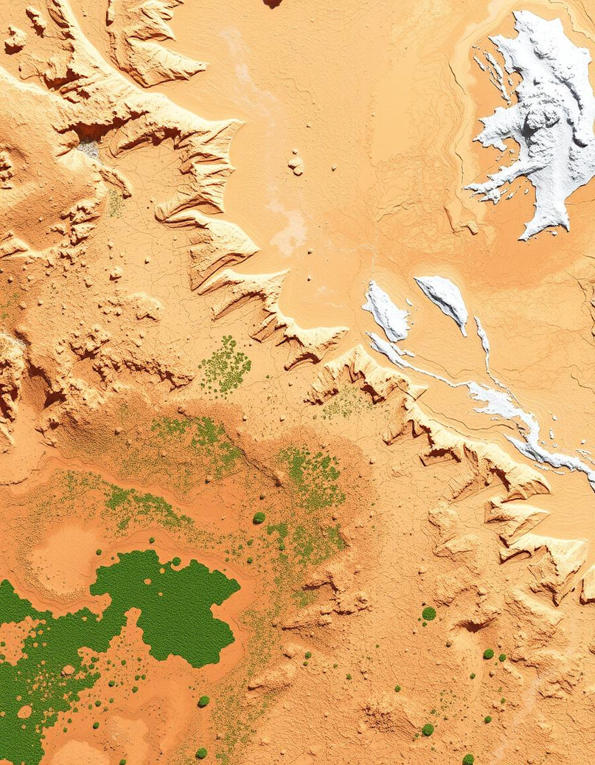
Task
Cluster a multispectral image using Kohonen Self-Organizing Map, with user-specified grid matrix size. Compute the mean-squared-error between the input image and the decoded image when the SOM is used as an image compressor by varying the grid size.

Slide 3

Introduction to Multispectral Imaging
What is it ?
Images captured at 3 to 15 spectral bands beyond visible RGB.
Data Structure
3D data cube: spatial (x,y) plus spectral dimensions.
Key Applications
Remote sensing
Agricultural monitoring
Environmental analysis

Slide 4
Kohonen Self-Organizing Map Overview
What It Does | How It Works
Performs unsupervised learning for clustering and visualization | Initialize weights for each node
Reduces dimensionality of high-dimensional data | Iterative weight adjustment
Transforms data into a 2D grid-based map | Update BMU & neighbors' weights using learning rate and distance
Preserves topological properties of the input space | Repeat over multiple iterations for convergence

Slide 5
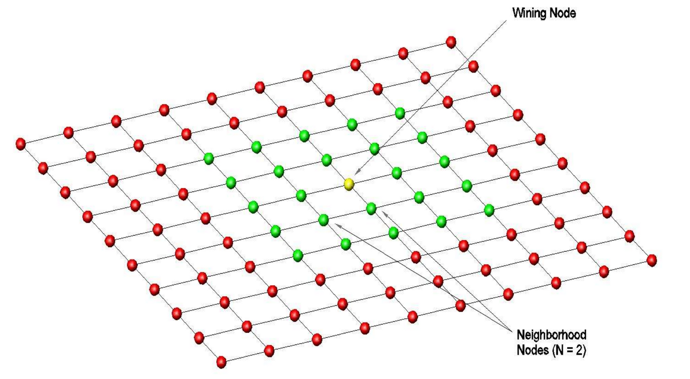

Slide 6


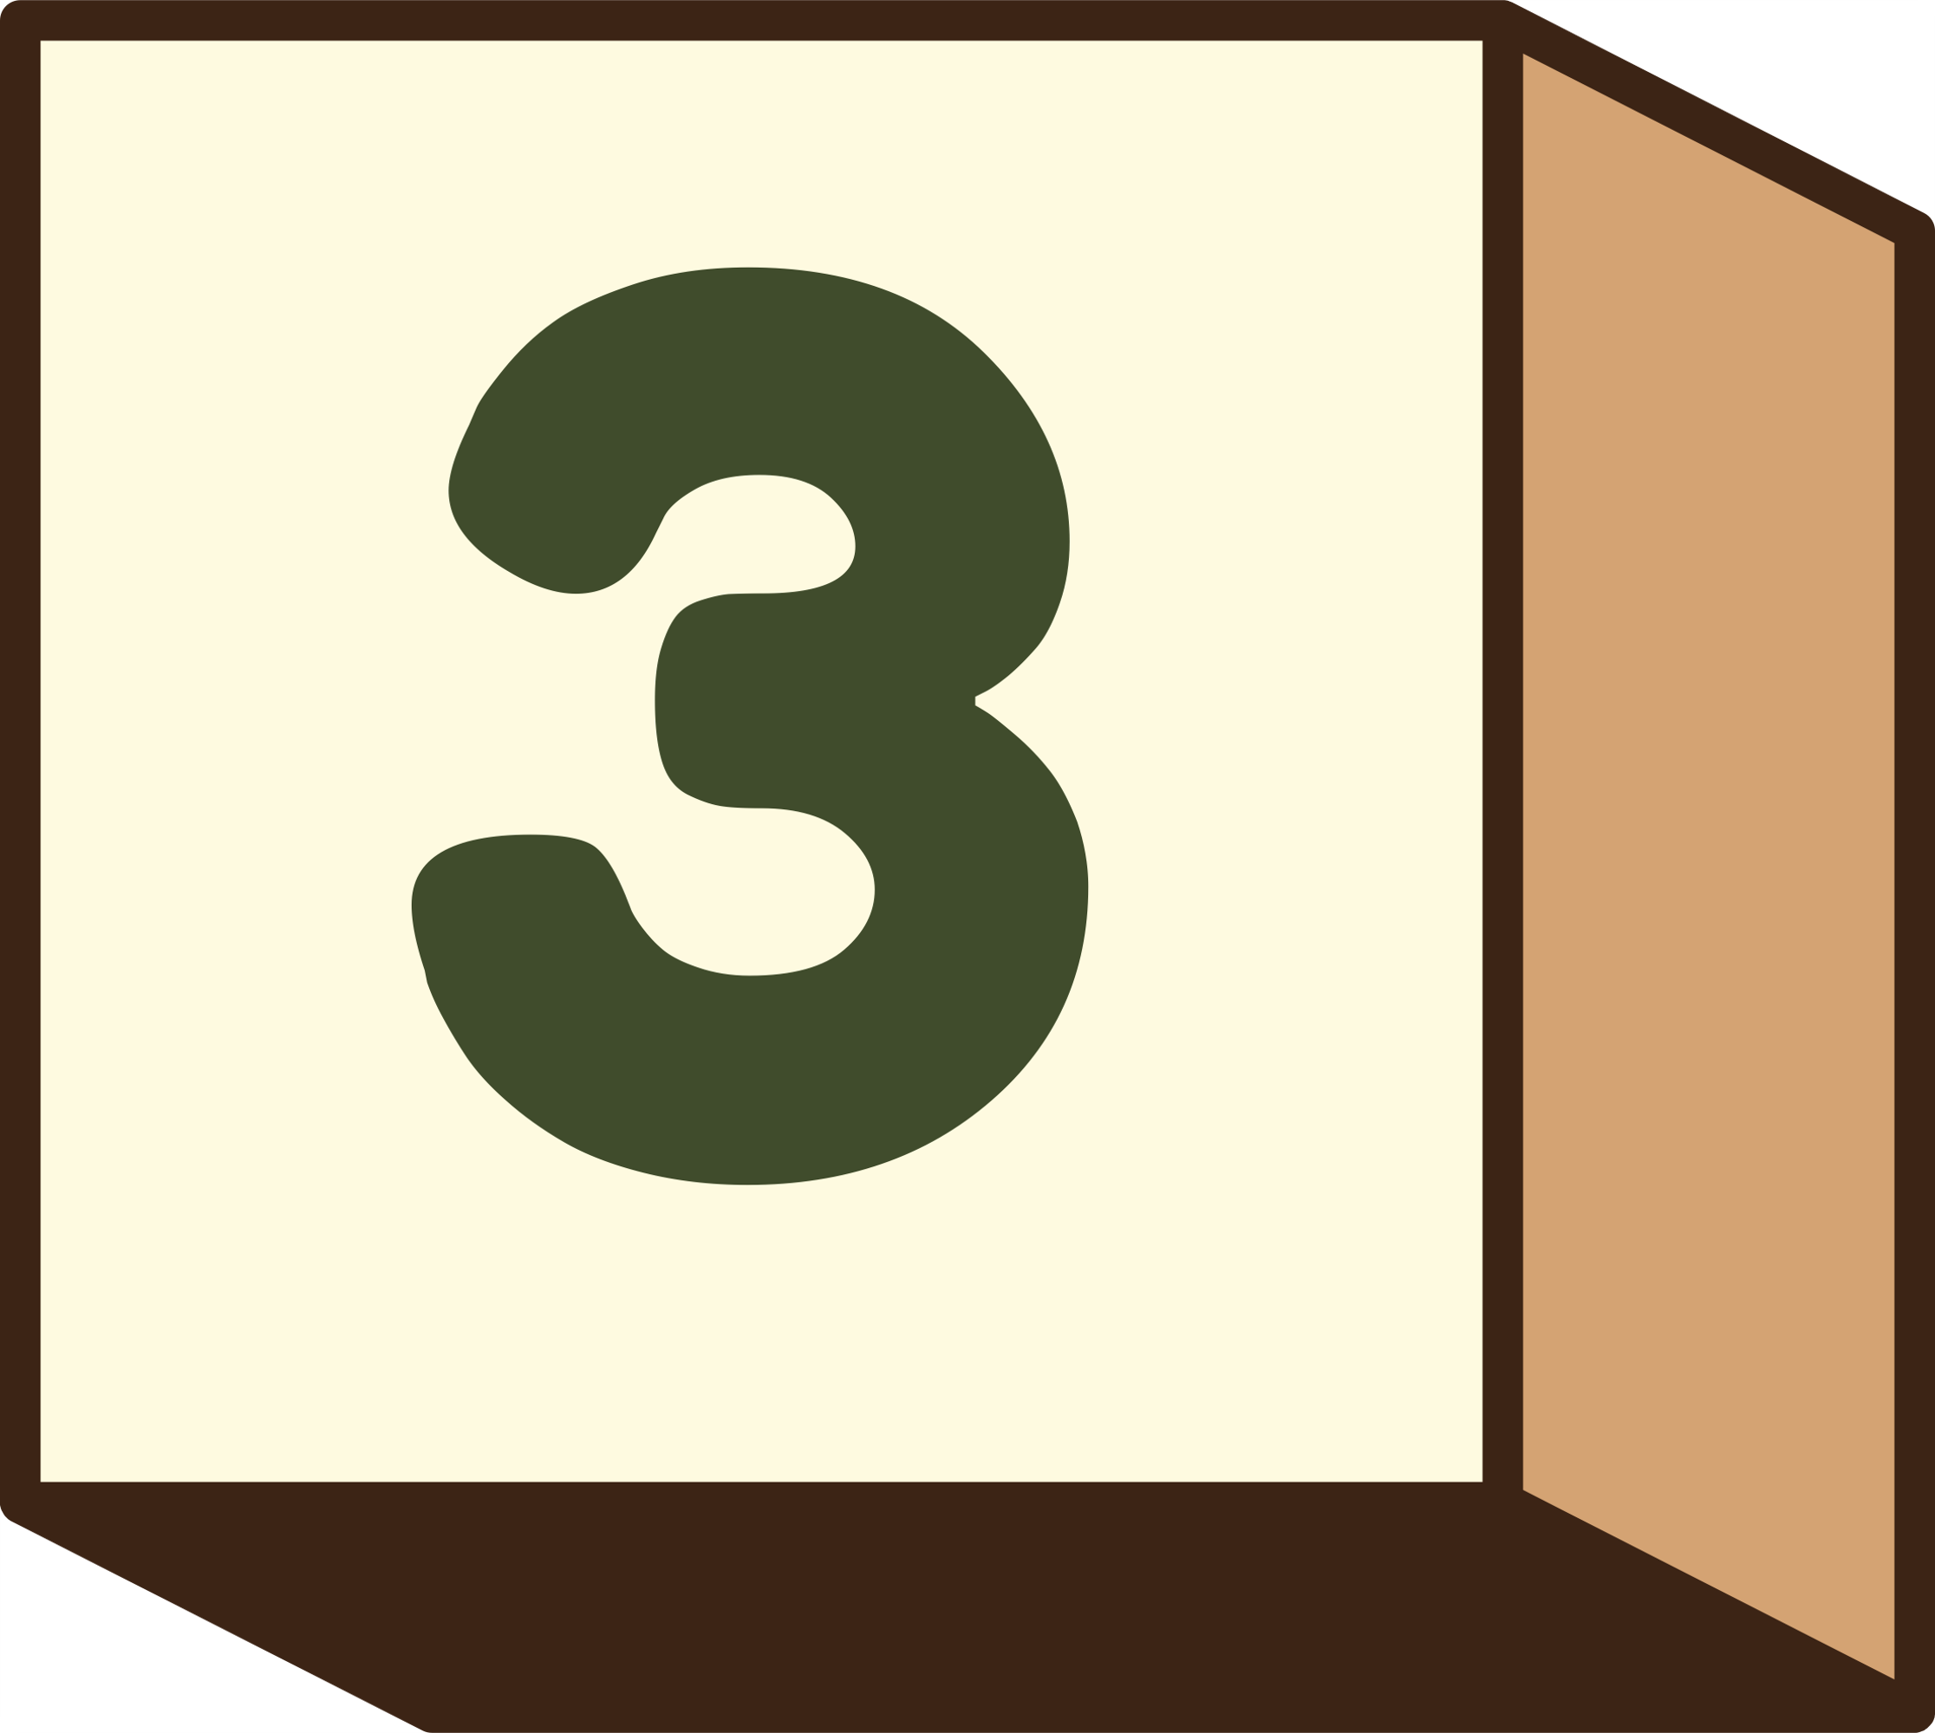
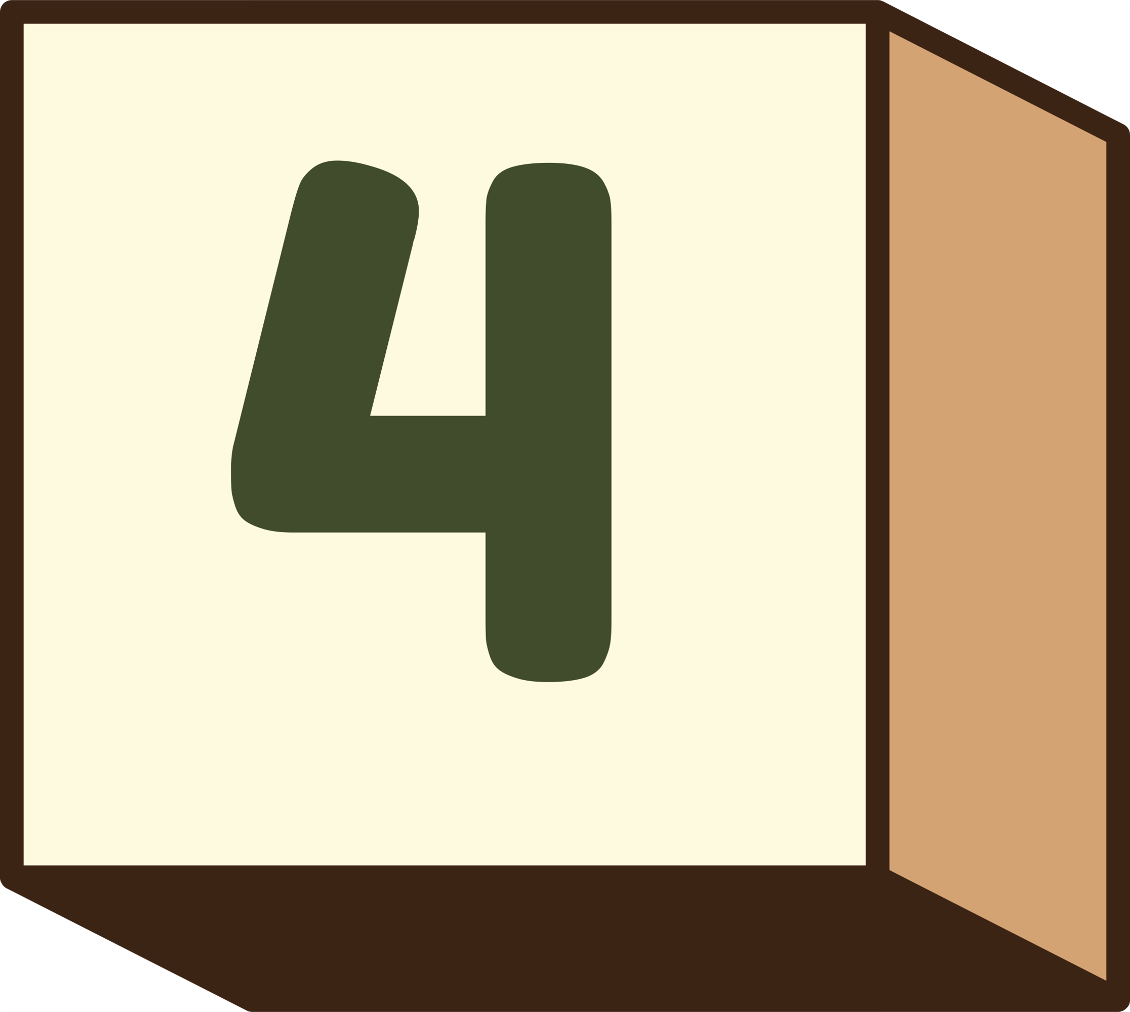
Methodology: SOM Clustering of Multispectral Image
Data Preparation
SOM Setup
Normalize and standardize input multispectral data cube.
Initialize using random weights.
Grid Sizes
Training
Test 4x4, 8x8, 12x12, 16x16, 20x20 user-specified maps
Set learning rate, neighborhood radius, and iterations

Slide 7

Methodology: Data Preparation
Band Selection
Image Stacking
Preprocessing
Downloaded TIFF images from the Copernicus Open Access Hub
Selected four key spectral bands:
Red (B4)
Green (B3)
Blue (B2)
Near Infrared (NIR, B8)
Focused on Sentinel data for high spatial and spectral resolution
Clipped images to Area of Interest (AOI)
Applied cloud masking
Normalized pixel values for consistent feature scaling
Stored processed data for further feature extraction or classification
Combined individual bands to form a multispectral image stack
Aligned bands spatially using georeferencing metadata
Created a single 4-channel array for unified analysis

Slide 8
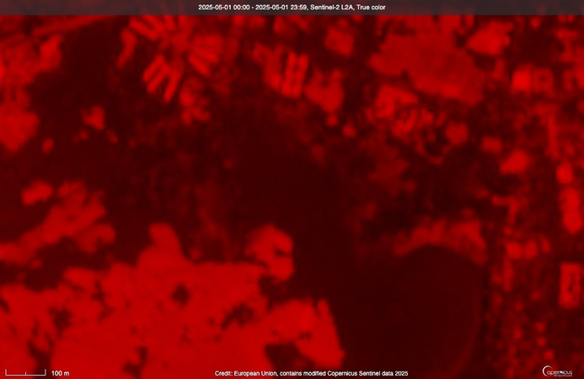
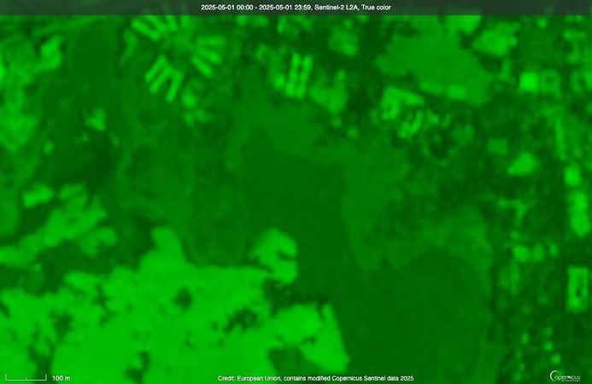
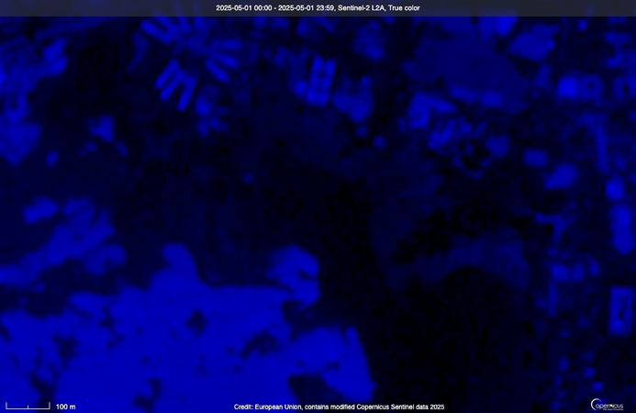

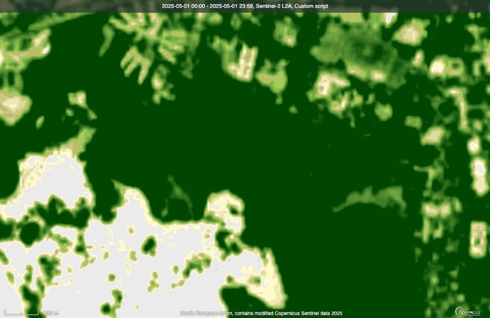
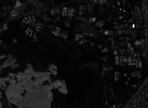
Red Band
Green Band
Blue Band
NIR Band
Multispectral

Slide 9

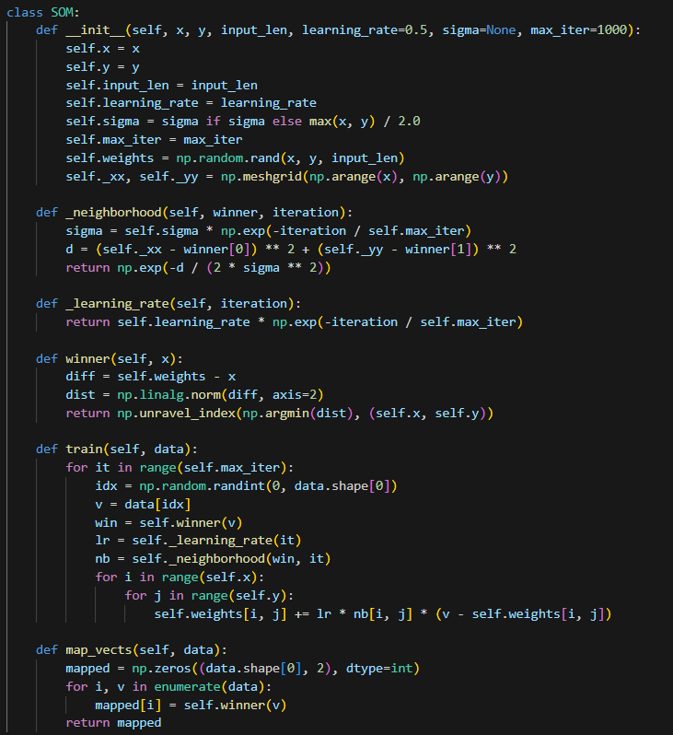
Methodology: SOM Setup & Training
Initialization (__init__)
Set grid size, input dimensions, learning rate, and initialize random weights
Winner Selection (winner)
Find Best Matching Unit (BMU) with minimum Euclidean distance to input
Neighborhood Function
Compute influence of BMU using Gaussian decay, reduces over time
Training & Mapping
Iteratively update BMU and neighboring weights; map each input to its BMU for visualization

Slide 10
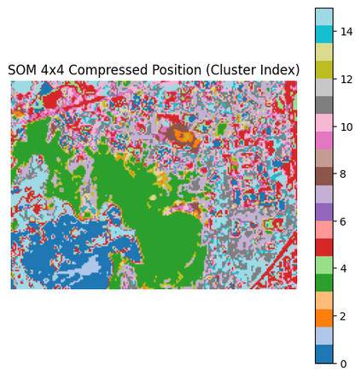
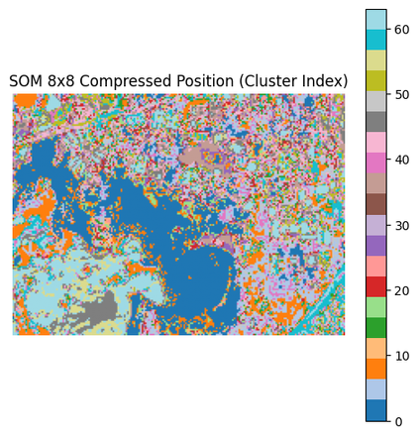
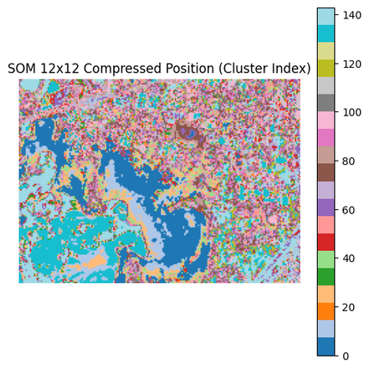
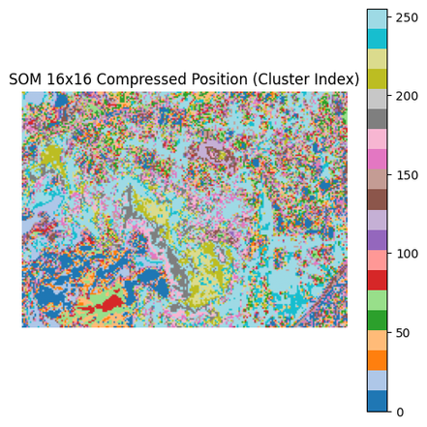
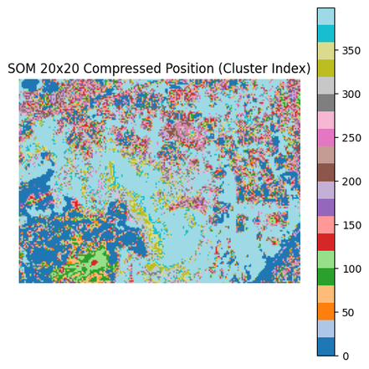
Results: Compressed Position Cluster

Slide 11
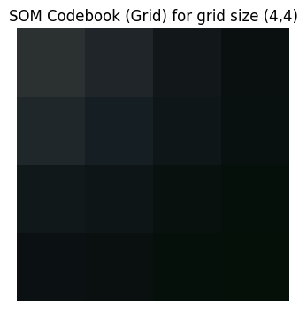
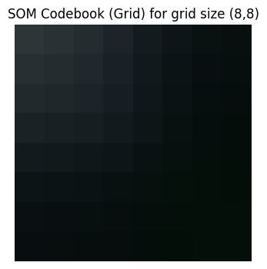
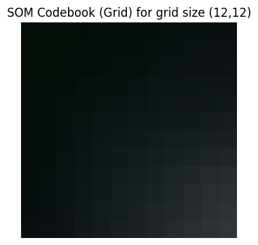
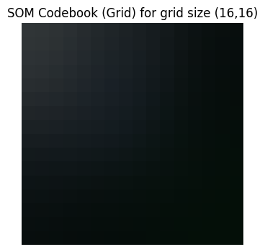
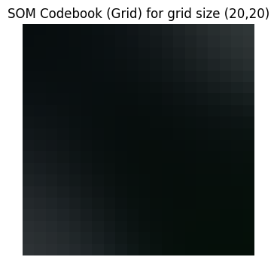
Results: Codebook for different sizes after training

Slide 12
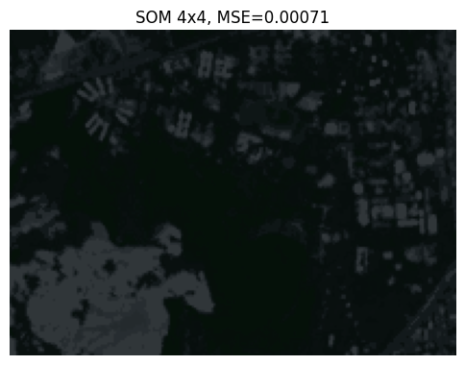
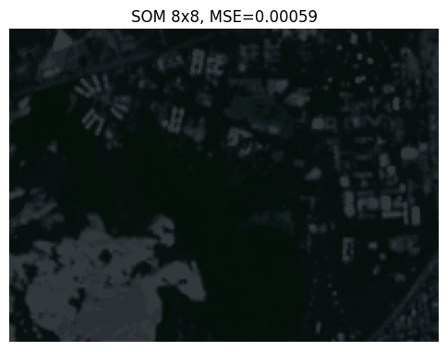
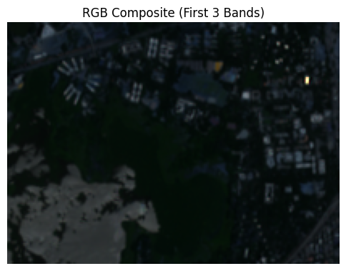
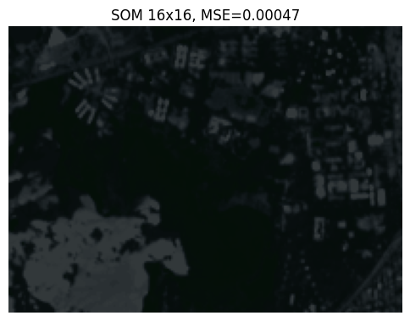
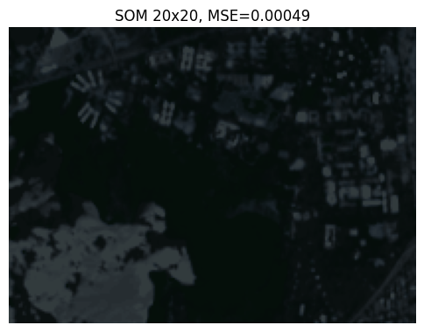
Results : Reconstructed Images from weights

Slide 13
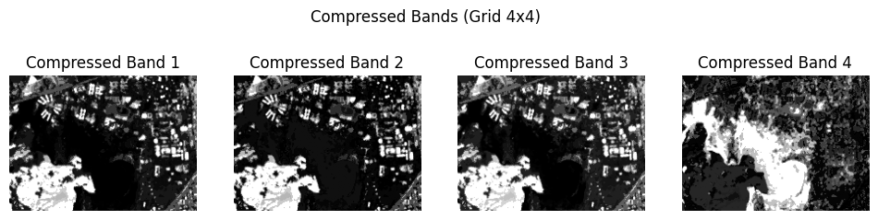
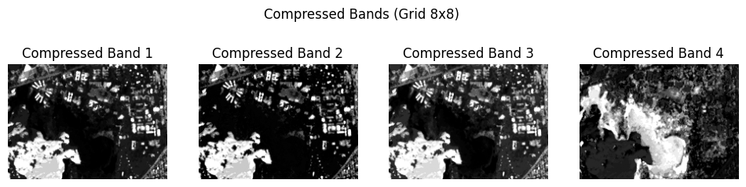
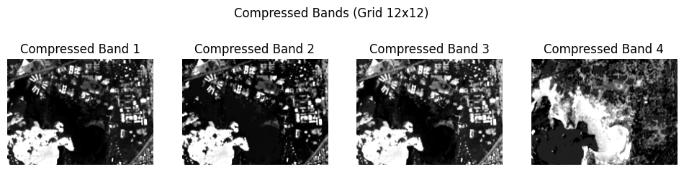
Results: Reconstructed Bands from weights

Slide 14
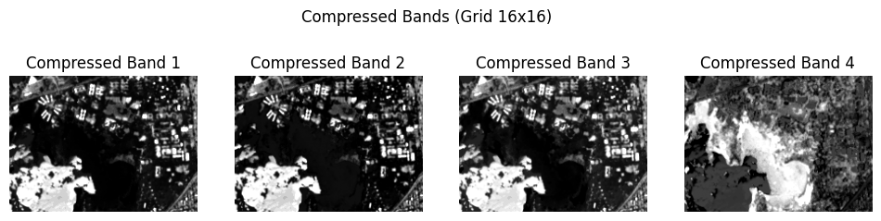
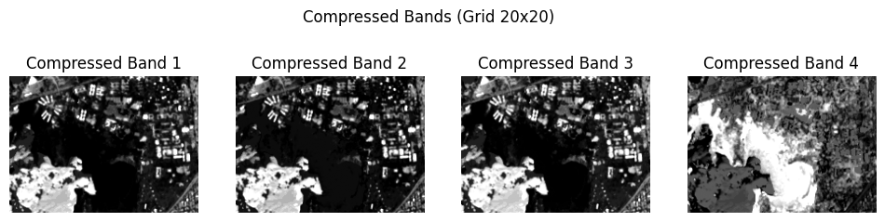
Results: Decompressed Images from weights

Slide 15
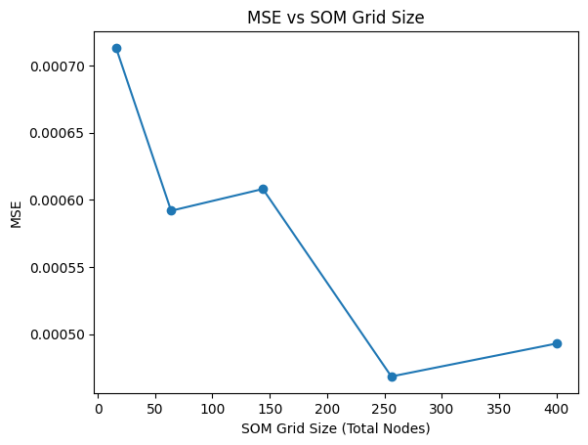
Results: MSE v/s Total Nodes
MSE decreases as grid size increases initially.
Best performance (lowest MSE) observed at grid size = 256 nodes.
Beyond 256 nodes, MSE slightly increases, indicating diminishing returns or possible overfitting.

Slide 16
Thank you

